Slide 1
CSE 2217
Design and Analysis of Algorithms – II
Single Source Shortest Path,
Dijkstra
Tahmid Mosaddeque
Lecturer
Department of CSE, UIU
Notes:
1

Slide 2
Shortest Path Problems
  shortest length between two vertices for an unweighted graph:
  smallest cost between two vertices for a weighted graph:
B
B
210
A
A
450
60
190
C
unweighted graph
C
weighted graph
200
130
D
D
E
E

Slide 3
Shortest Path Problems
How can we find the shortest route between two points on a map?
Model the problem as a graph problem:
  Road map is a weighted graph:
vertices = cities
edges = road segments between cities
edge weights = road distances
  Goal: find a shortest path between two vertices (cities)
3

Slide 4
Shortest Path Problems
Input:
  Directed graph G = (V, E)
  Weight function w : E → R
Weight of path p = ⟨v₀, v₁, . . . , v_{k}⟩
Shortest-path weight from u to v:
δ(u, v) = min w(p) : u v if there exists a path from u to v
∞ otherwise
Shortest path u to v is any path p such that w(p) = δ(u, v)
t
x
3
6
9
3
4
s
0
2
1
2
7
5
3
5
11
$$w\left(p\right)=\sum_{i=1}^{k}{w\left(v_{i−1},v_{i}\right)}$$
6
y
z
p
4

Slide 5
Variants of Shortest Paths
Single-source shortest path
  G = (V, E) ⇒ find a shortest path from a given source vertex s to each vertex v ∈ V
Single-destination shortest path
  Find a shortest path to a given destination vertex t from each vertex v
  Reverse the direction of each edge ⇒ single-source
Single-pair shortest path
  Find a shortest path from u to v for given vertices u and v
  Solve the single-source problem
All-pairs shortest-paths
  Find a shortest path from u to v for every pair of vertices u and v
5

Slide 6
Why don’t we use BFS?
In case of unweighted graph, BFS is able to find the shortest path.
What about weighted graph?
  Why not?

Slide 7
Optimal Substructure of Shortest Paths
Given:
  A weighted, directed graph G = (V, E)
  A weight function w: E → R,
  A shortest path p = ⟨v₁, v₂, . . . , v_{k}⟩ from v₁ to v_{k}
  A subpath of p: p_{ij} = ⟨v_{i}, v_{i+1}, . . . , v_{j}⟩, with 1 ≤ i ≤ j ≤ k
Then: p_{ij} is a shortest path from v_{i} to v_{j}
Proof: p = v₁ v_{i} v_{j} v_{k}
w(p) = w(p_{1i}) + w(p_{ij}) + w(p_{jk})
Assume ∃ p_{ij}’ from v_{i} to v_{j} with w(p_{ij}’) < w(p_{ij})
⇒ w(p’) = w(p_{1i}) + w(p_{ij}’) + w(p_{jk}) < w(p) contradiction!
v_{j}
p_{ij}
p_{jk}
v₁
p_{1i}
p_{ij}’
v_{k}
v_{i}
p_{1i}
p_{ij}
p_{jk}
7

Slide 8
Shortest-Path Representation
For each vertex v ∈ V:
d[v] = δ(s, v): a shortest-path estimate
  Initially, d[v]=∞
  Reduces as algorithms progress
π[v] = predecessor of v on a shortest path from s
  If no predecessor, π[v] = NIL
  π induces a tree—shortest-path tree
Shortest paths and shortest path trees are not unique
t
x
3
6
9
3
4
s
0
2
1
2
7
5
3
5
11
6
y
z
8

Slide 9
Initialization
Alg.: INITIALIZE-SINGLE-SOURCE(V, s)
for each v ∈ V
do d[v] ← ∞
π[v] ← NIL
d[s] ← 0
All the shortest-paths algorithms start with INITIALIZE-SINGLE-SOURCE
9

Slide 10
Relaxation
Relaxing an edge (u, v) = testing whether we can improve the shortest path to v found so far by going through u
If d[v] > d[u] + w(u, v) : improve the shortest path to v ⇒ update d[v] and π[v]
s
s
u
v
u
v
After relaxation:
d[v] <= d[u] + w(u, v)
5
2
9
5
2
6
RELAX(u, v, w)
RELAX(u, v, w)
u
v
u
v
5
2
9
5
2
6
10

Slide 11
RELAX(u, v, w)
if d[v] > d[u] + w(u, v)
then d[v] ← d[u] + w(u, v)
π[v] ← u
All the single-source shortest-paths algorithms
  start by calling INIT-SINGLE-SOURCE
  then relax edges
The algorithms differ in the order and how many times they relax each edge
11

Slide 12
Dijkstra’s Algorithm
Single-source shortest path problem:
  No negative-weight edges: w(u, v) > 0 ∀ (u, v) ∈ E
Maintains two sets of vertices:
  S = vertices whose final shortest-path weights have already been determined
  Q = vertices in V – S: min-priority queue
    Keys in Q are estimates of shortest-path weights (d[v])
Repeatedly select a vertex u ∈ V – S, with the minimum shortest-path estimate d[v]
12

Slide 13
Dijkstra (G, w, s)
t
1
x
INITIALIZE-SINGLE-SOURCE(V, s)
S ← empty
Q ← V[G]
while Q ≠not empty
do u ← EXTRACT-MIN(Q)
S ← S union {u}
for each vertex v ε Adj[u]
do RELAX(u, v, w)
∞
∞
10
9
s
0
2
3
4
6
5
7
∞
∞
2
y
z
t
1
x
∞
∞
10
10
9
s
0
2
3
4
6
5
7
∞
∞
5
2
y
z
13

Slide 14
Example
t
1
x
t
1
x
10
∞
8
14
8
14
13
10
9
10
9
s
0
2
3
4
6
s
0
2
3
4
6
5
7
5
7
5
∞
5
7
7
2
2
y
z
y
z
t
x
t
1
x
1
8
9
8
13
9
10
9
10
9
2
3
4
6
s
0
2
3
4
6
s
0
5
7
5
7
5
7
5
7
2
2
y
z
y
z
14

Slide 15
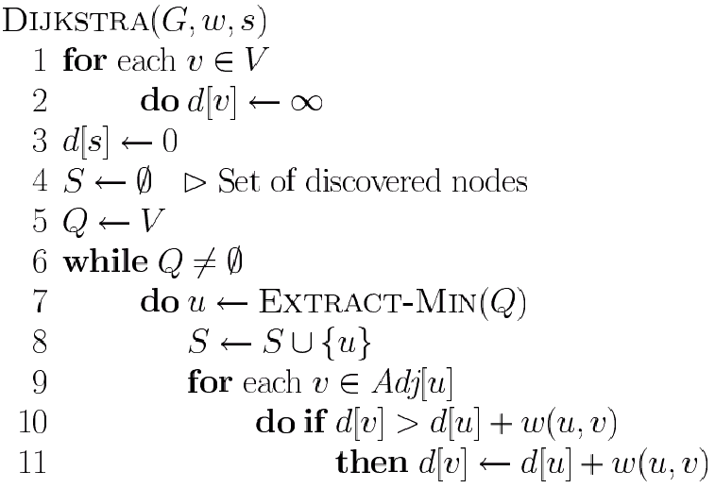
Dijkstra’s Pseudo Code
Graph G, weight function w, root s
relaxing edges

Slide 16
Dijkstra (G, w, s)
INITIALIZE-SINGLE-SOURCE(V, s)
S ← ∅
Q ← V[G]
while Q ≠ ∅
do u ← EXTRACT-MIN(Q)
S ← S ∪ {u}
for each vertex v ∈ Adj[u]
do RELAX(u, v, w)
Running time: O(VlgV + ElgV) = O(ElgV)
Θ(V)
O(V) build min-heap
Executed O(V) times
O(lgV)
O(E) times; O(lgV)
16

Slide 17
Dijkstra’s Running Time
Extract-Min executed |V| time
Decrease-Key executed |E| time
Time = |V| T_{Extract-Min} + |E| T_{Decrease-Key}
T depends on different Q implementations
Q | T(Extract-Min) | T(Decrease-Key) | Total
array | Ο(V) | Ο(1) | Ο(V ²)
binary heap | Ο(lg V) | Ο(lg V) | Ο(E lg V)
Fibonacci heap | Ο(lg V) | Ο(1) (amort.) | Ο(V lgV + E)

Slide 18
Question
Prove that, if there exists negative edge, Dijkstra’s shortest path algorithm may fail to find the shortest path
Print the shortest path for Dijkstra’s algorithm
Suppose you are given a graph where each edge represents the path cost and each vertex has also a cost which represents that, if you select a path using this node, the cost will be added with the path cost. How can it be solved using Dijkstra’s algorithm?
18

